Slide 1
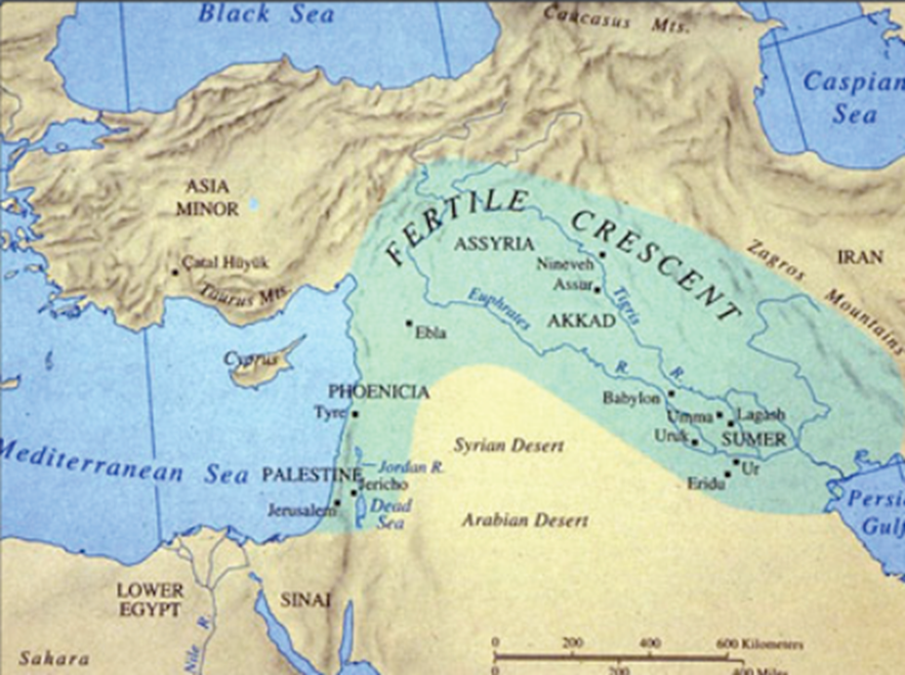
Mesopotamia
The Land Between Rivers

Slide 2
Ancient Mesopotamia Map

Slide 3
Geography
CURRENT DAY LOCATION
Location: Tigris-Euphrates Valley (part of the Fertile Crescent)
Northern Flood Plains = Assyria
Present-day Iraq, Kuwait and Syria

Slide 4
What were the Civilizations in the Flood Plains of Mesopotamia?
Southern Mesopotamia = Sumer
Central Mesopotamia = Akkad
United by Babylonians = Babylonia

Slide 5
What role did the rivers and levees have in creating a region that could support a civilization?
Rivers fed by the spring rains and snowmelt from the Zagros Mtns.
There were many UNPREDICTABLE floods
Rivers formed numerous infertile alluvial plains but MANY fertile levees.

Slide 6
Levees Levees created by flooding and were surrounded by wetlands Levees were the sites of the first permanent settlements Levees provided high ground during floods

Slide 7
Wait, where does the water come from???
Isn’t the Middle East a Desert?
Isn’t the Middle East really, really dry???

Slide 8
Zagros Mountains
Nowadays Iran
These are over 1,500km

Slide 9
The “Cradle of Western” Civilization
The convergence of the Tigris and Euphrates rivers produced rich fertile soil and a supply of water for irrigation.
The civilizations that emerged around these rivers are among the earliest known non-nomadic agrarian societies.
From Mesopotamia we find the first signs of a VILLAGE
In this cradle there was the first signs of EARLY-TEMPLE cities

Slide 10
The “Cradle of Civilization” Continuation
In southern Mesopotamia was the earliest signs of civilization
The first sign was over 5,000 BCE and there was
Ziggurats
Shrines
Arches
Some kind of a water conduit

Slide 11
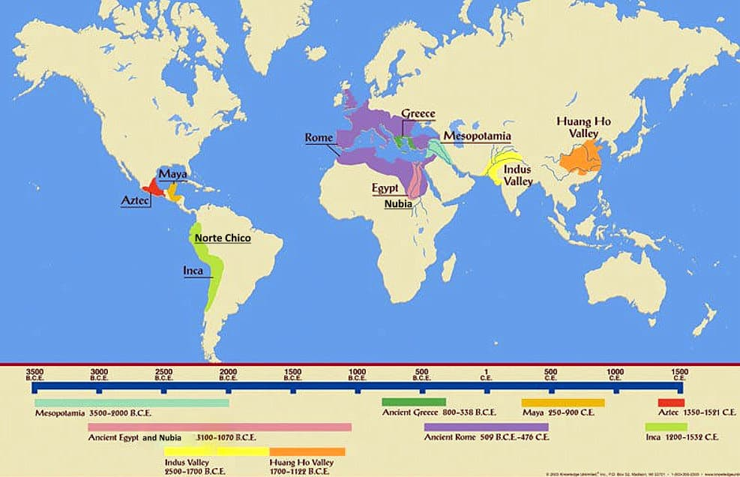
Is there more than “One Cradle for Civilization?” - Yes

Slide 12
Part 3 – Cultural Groups
The region was not a unified empire, but a collection of civilizations which dominated the area at different times.
The FOUR main civilizations that dominated the region are the:
Sumerians
Akkadians
Babylonians
Assyrians

Slide 13
Who Were the Sumerians?
Arrived from Central Asia ~ 3 BCE
First settlement: Eridu
Had intensive agriculture year round Crop survival depended on irrigation: shadufs, canals, channels, dikes, weirs and reservoirs.
They grew barley, chickpeas, lentils, wheat, dates, onions, garlic, lettuce, leeks and mustard.
The raised cattle, sheep, goats and pigs. Caught fish and gazelles.
They used oxen and donkeys as beasts of burden.

Slide 14
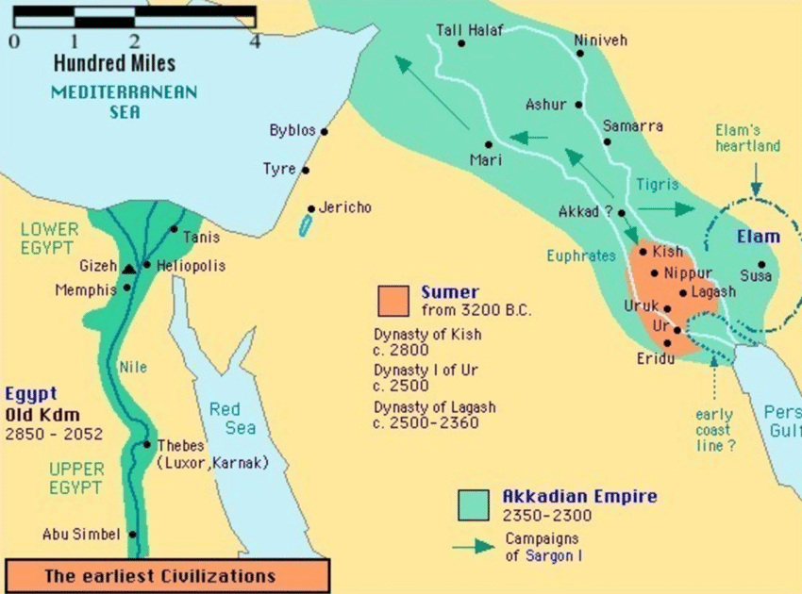
Sumer and Akkadian Empire

Slide 15
Sumerian Society & Structure
Started to organize in large societies
I. Ruling Class
Nobility (king and his family – in charge oof everything and everyone
chief priests – intermediaries between the gods and humanity – the only ones who could enter the temple where the god resides
High Palace Officials – upper beurocracy
II. Upper Class Commoners - people whose livelihood depended on the nobility,
-Included government officials and scribes who kept records for the city state
III. Lower Level Commoners (land-owning, free citizens who relied on themselves)
-included merchants and traders, as well as artisans and farmers
IV. Enslaved people – chattel slavery was practiced, as well as slave status to work of debts

Slide 16
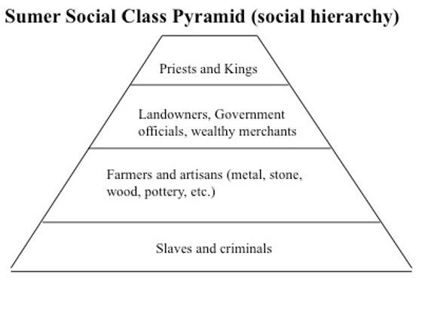
This social structure persisted throughout most of Mesopotamia’s history, across all empires.

Slide 17
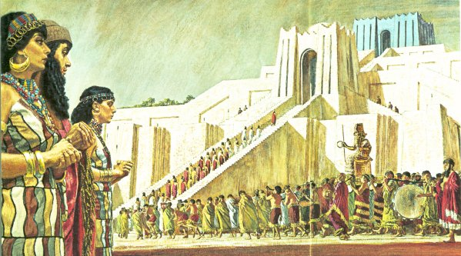
Festivals
Ancient Mesopotamians had ceremonies each month. The theme of the rituals and festivals for each month is determined by SIX important factors:
The Phase of the Moon
The phase of the annual agricultural cycle
Equinoxes and solstices
The local mythos and its divine Patrons
The success of the reigning Monarch
Commemoration of specific historical events (founding, military victories, temple holidays, etc.)

Slide 18
What About their Writing?
Written language allowed transmission of wisdom and knowledge; for laws to be codified, and for records to be kept to facilitate trade.
First written language was Sumerian cuneiform discovered 3500 BCE in Uruk.
Sumerian cuneiform “wedge-shaped”.
A stylus was pressed into soft clay (main too)
Other mediums and tools: stone and chisel; metal and chisel; and terracotta and paint.
Sumerians only used writing for keeping records.
Cuneiform spread into Persia and Egypt; which became the international script and medium for cultural exchange.

Slide 19
Cuneiform The earliest form of a written language

Slide 20
Mathematics
They used a number system that would be the source of:
60 Minutes in an hour
24 Hours a day
7 Days a Week
Calendar had 365 Days

Slide 21
Science & Technology
Prosperous life included agriculture and writing.
First wheeled vehicle appeared in the 4000 BCE
Solid wooden wheels pulled by oxen.
Other inventions: seeder-plows and pickaxes
Efficiencies led to specializations in baking, brewing, weaving and tanning.

Slide 22
Governance
The strongest and most able man became king – lugal(translated as strong man)
Was somewhat democratic then eventually became monarchial.

Slide 23
Warfare
Fragment of the Stele of the Vultures showing marching soldiers.
Many walled cities were built
Distant villages were abandoned
Cities spheres would overlap
Monuments to celebrate military victories were built

Slide 24
Akkad & the Akkadians
Akkadians were already in Mesopotamia by the arrival of the Sumerians
Akkadians were semites.
Empire centered around Akkad, the capital.
Akkad became capital once Sargon I unified Lower Mesopotamia: 2331 BCE
Akkadian conquest and appropriation of Sumer and Sumerian culture.

Slide 25
Sargon I
Sargon I (reign 2270-2215 BC)*
continued what the Sumerians started.
patronized the Sumerians gods: Anu, Enlil, and
Nanna
expanded the empire from the Persian Gulf to the
Mediterranean and to the Caspian Sea.

Slide 26
Sargon’s Legacy
Sargon was succeeded by his second son, Rimush.
His 9 year reign was plagued with revolts.
Rimush was succeeded by his older brother Man-ishtushu.
His 15 year reign was plagued with revolts as well.
Man-ishtushu was succeeded by his son Naram-Sin/Naran-
Suen and ruled for 56 years.
By 2200 BC Akkadian falls to invading barbarians
After the fall, Mesopotamia enters disunion

Slide 27
Babylon - Famous Archeological Sites
Tower of Babel
Hanging Gardens of Babylon

Slide 28
Hammurabi
Mesopotamia reunited under Hammurabi
Hammurabi (1796-1750 BCE) :
Akkadian Amorite
First king of the Babylonian Empire (ca. 1750 BCE)
Took control of what was left of Akkad and conquered neighbouring kingdoms such as Assyria.
Mesopotamia flourished only to decline by 1550 BCE.
The following years before the rise of the Assyrian
Empire is marked by Hurrian invasions.

Slide 29
Assyrians
Rose to prominence in the 10th Century when Adadnirari II ascended the throne in 911 BC.
Extremely militaristic
World view was based on expanding their empire.
Known to use extreme force and relocation to enforce their rule
Were able to capture parts of northern Egypt
The empire stretched from Persian Gulf to Syria and Palestine.

Slide 30
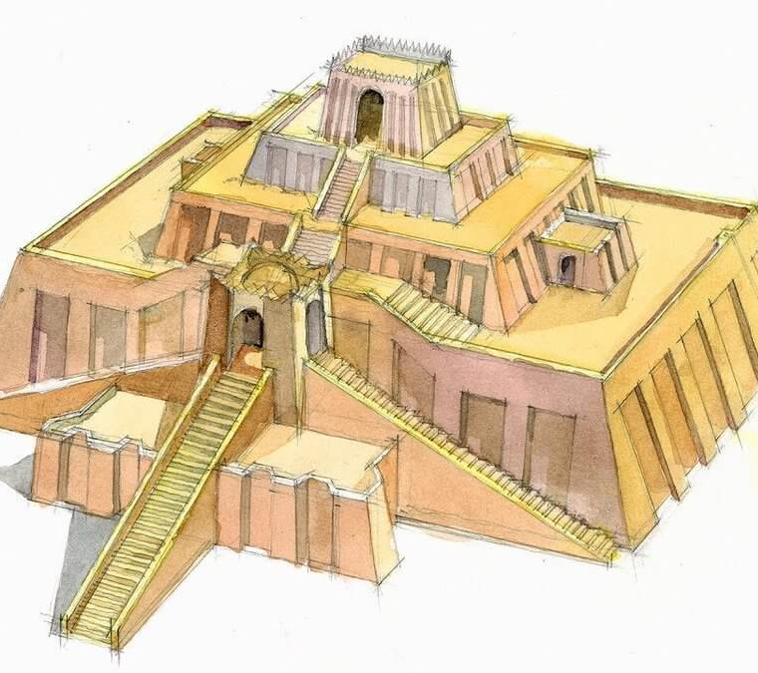
Ziggurats
A temple tower of ancient Mesopotamia, having the form of a terraced pyramid of successively receding stories.
Place to honour the gods, as required (also a place to escape rising flood waters)
Began as small shrines made of mud bricks floods forced the construction of higher and higher platforms
The 1st one was built 4000 BCE during and the last one was built in 500 BCE. They were built by the Sumerians, Babylonians, Elamites, and Assyrians.
Well-known example Tower of Babel
Four Common Architechtual Traits:
Incremental platform steps
The top was flap
Had no internal chambers
A massive main staircase at the front, with possibly others branching off

