Slide 1
What’s on for today
1) Halloween – costume – yes or no?
2) Worst Jobs
3)What’s going on in the world?

Slide 2
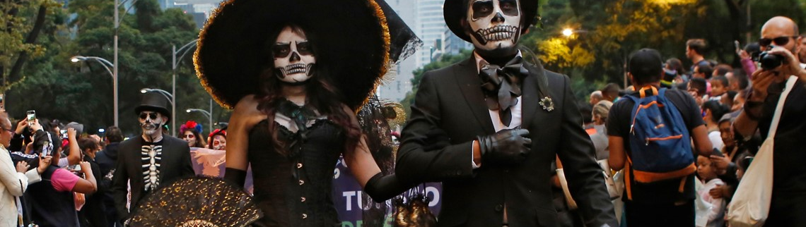
Halloween – Are you dressing up?

Slide 3
What is going on in the world today?

Slide 4
Our world is constantly changing, and as a member of it, you should stay informed.

Slide 5
Brainstorm: What are some of the big themes and ideas we look at in Social Studies?

Slide 6
Brainstorm: What are some of the big themes and ideas we look at in Social Studies?
Politics Culture Art
Economy Beliefs traditions Why traditions change
Why society changes National Identity
How do events affect life and culture Leadership Why do rebellions happen?
Technology and innovation – what effect do they have? How do they change our world?
Economic systems Natural disasters War and conflict

Slide 7
Find an article connected with a theme in Social Studies.
There are many, many news sources linked to the Current Events page on the website!

Slide 8
Overview:
The assignment has a written and an oral component.
Presentation:
a summary of the article to the class
any dilemmas or questions you feel the piece presents
your opinion about it
ask the class two discussion questions
Written(about 1 page typed):
hand in a written summary
how this topic connects with class
your opinion about the topic
***Attach the rubric to your written summary!!!***

Slide 9
Choosing an article that relates to Social Studies:
Two possibilities:
Direct connection – ie. Discovery of an Aztec artifact
Thematic connection - politics, national
identity, social change, technology, economy,
natural disasters, rebellion, war and conflict…

Slide 10
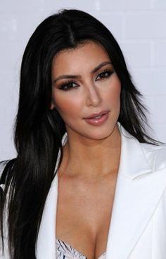
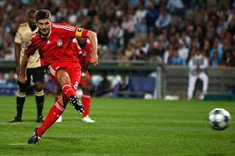
No sports, celebrity gossip, entertainment, etc.

Slide 11
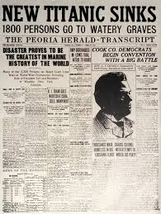
Attach a copy of the article along with your assignment.

Slide 12
The Written Part
Source Information
Summary of the article
Connection to themes and your thoughts and opinions
Two open ended discussion questions.
The rubric should be attached to the
written summary.

Slide 13
Summary of the article
Identifies most facts from the event that are relevant and important to understanding.
The article is very relevant.

Slide 14
Personal Commentary and Opinion - Significance
Clearly identifies event’s significance and possibly from a variety of perspectives.
Expresses a clear and supported opinion.
In-depth understanding of the significance of the article / issue.

Slide 15
Two discussion questions based on the article.
These need to be open ended.
(Questions that have more than one possible response.)

Slide 16
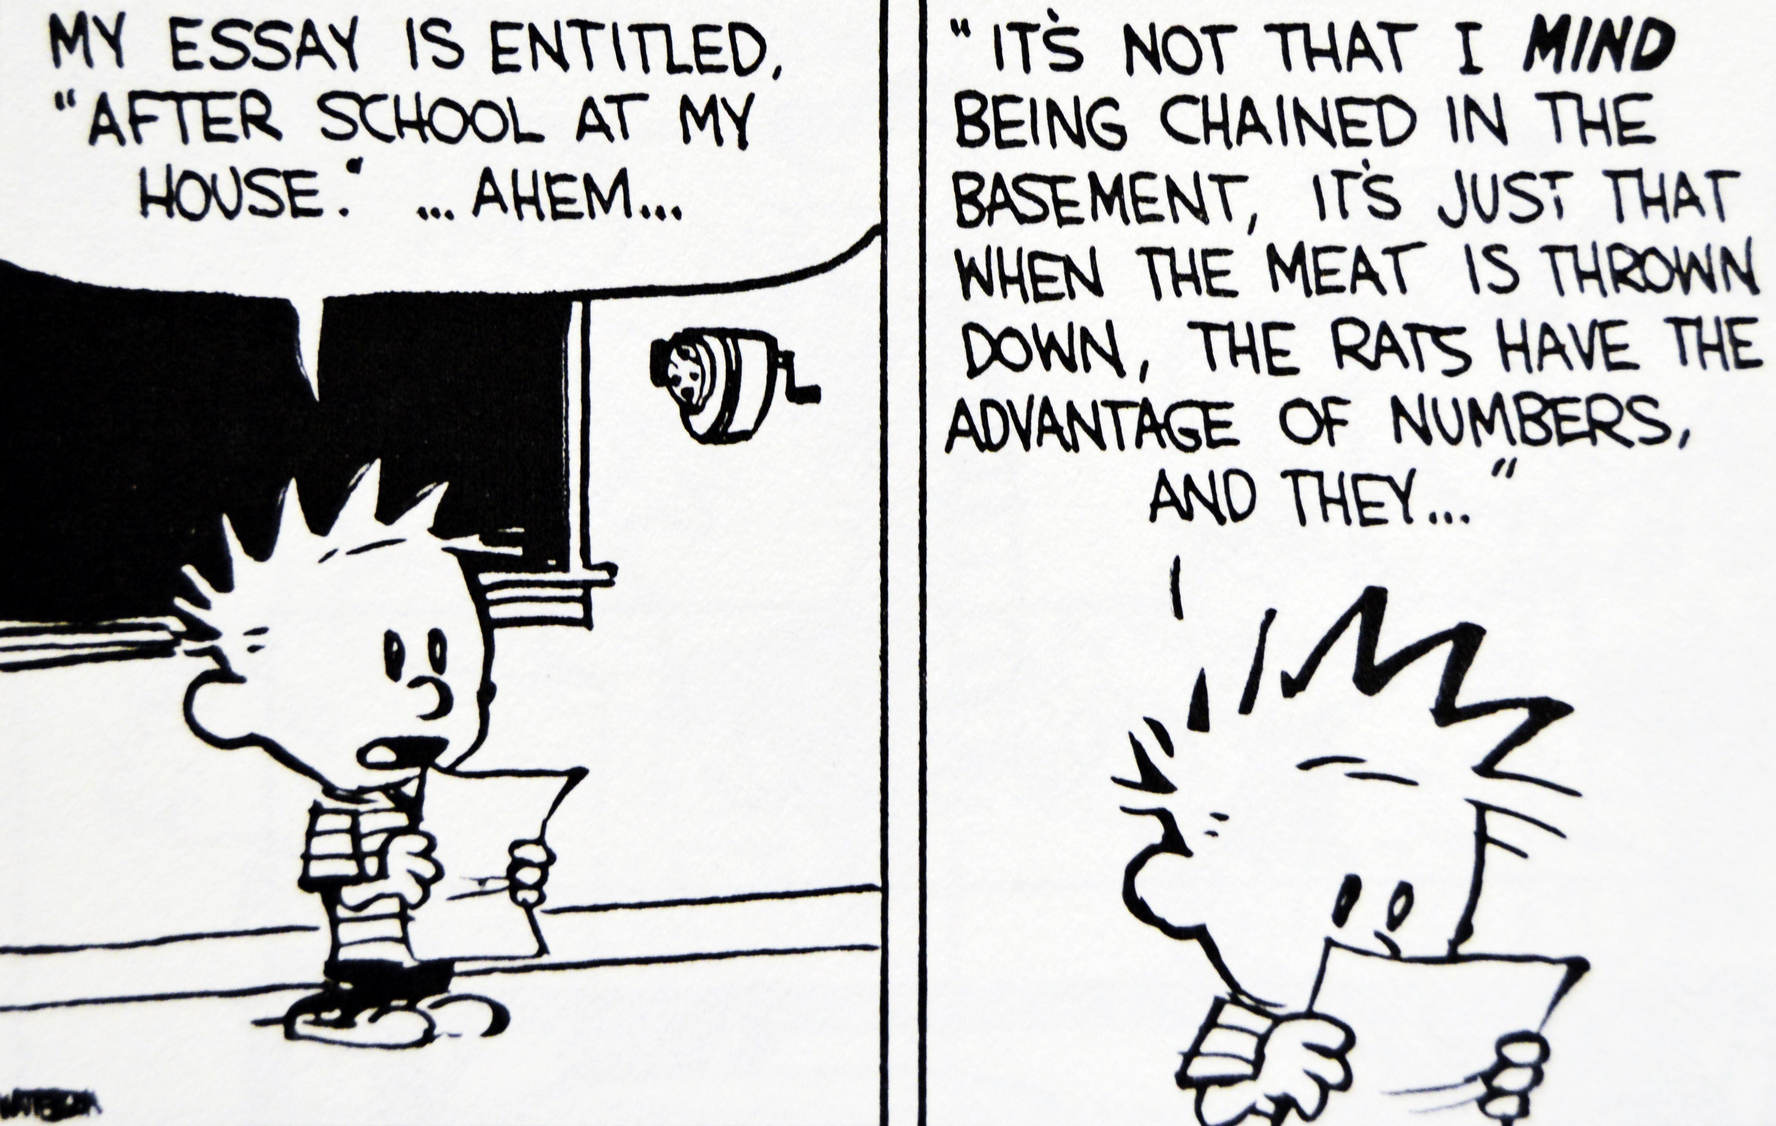
On your day to present, you will be expected to present and discuss your article in class for 5 minutes.

Slide 17
Oral Presentation
eye contact
loud, clear voice
posture and presence
stay on topic
try to speak rather than read – use speaker notes (not a script)

Slide 18
Photos, maps, logos, charts and film clips can help clarify your topic and help focus the audience.
If you are putting images onto a power
point avoid including notes.
Film clips should only be a few minutes
long at the most.
You may use film clips or images if you wish.

