Slide 1
Recipe for a civilization

Slide 2
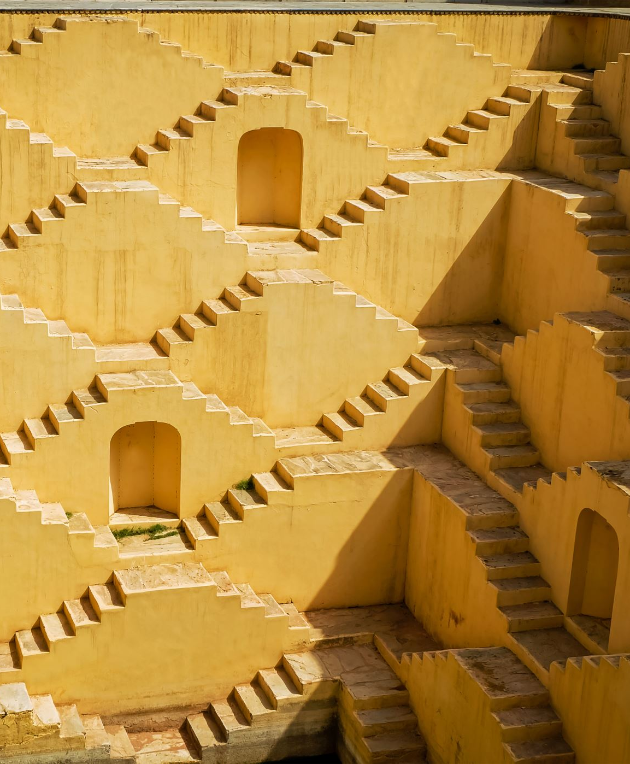
What is a civilization?
From the list provided, select the eight necessary characteristics that must be present in order for a civilization to exist.

Slide 3
Rank the following in importance in establishing and maintaining a civilization:
Art Religion
Cities
Government
Social Structure
Writing

Slide 4
5 Characteristics
1) Agricultural Intensification
2) Permanent Towns and Settlements
3) Specialization in Occupations
4)Record Keeping / Writing
5) Complex Institutions
Government and law
State religion
Banking/financial system
Social Class Structure
Notes:
Image not in source images

Slide 5
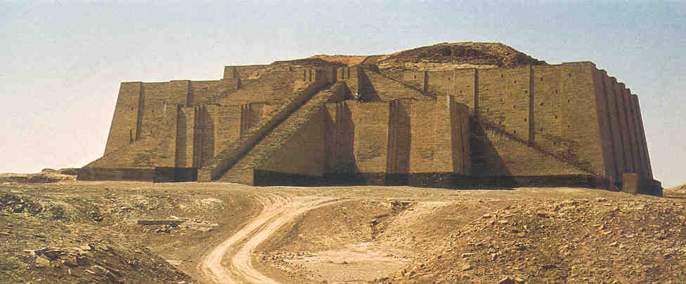
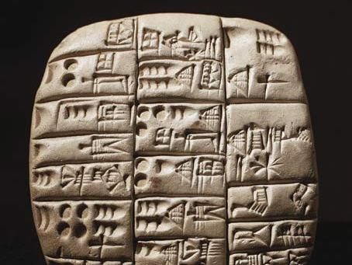
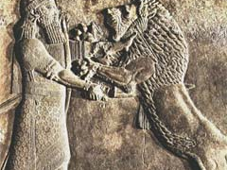
What is a Civilization? What is Culture?
Notes:
Mesopotamia - Cuneiform Writing on Tablet
Mesopotamian art - King repelling a lion
Ziggurat of Ur, Iraq

Slide 6
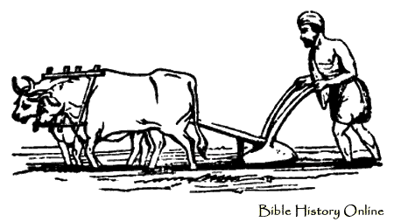
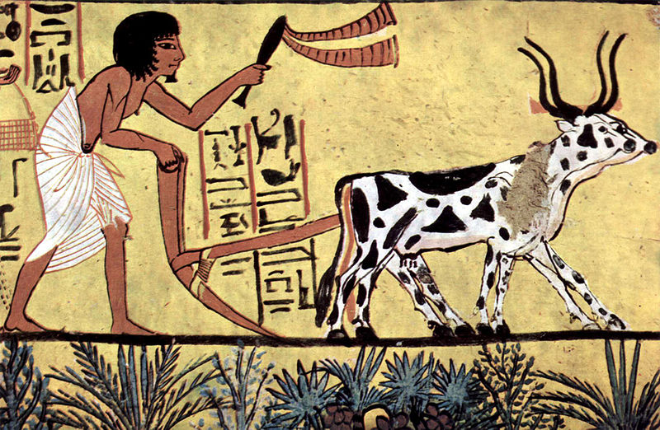
Agriculture
Seen as most important factor in development of civilization
Farming allowed people to settle in one place
Dogs were the first animals to be domesticated (33,000 years ago)
Sheep were also domesticated early on (10,000-11,000 years ago)
Development of agriculture (farming) to the point where farmers are able to produce a surplus of food.
In order to develop agriculture to this point, farmers must be capable of using techniques such as crop rotation, use of animal power, and/or irrigation.
A major part of the population does not spend most of their time producing food. They can go into other occupations and trade for or buy the food they need and this is called "specialization of labor.”
Notes:
agricultural_operation
Burial chamber of Sennedjem, Scene - Plowing farmer (ca. 1200 bc)
A gallic-roman harvester. Relief from Trier

Slide 7
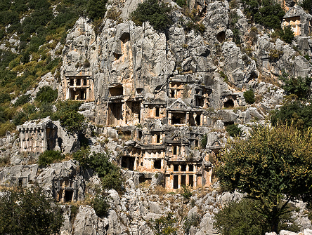
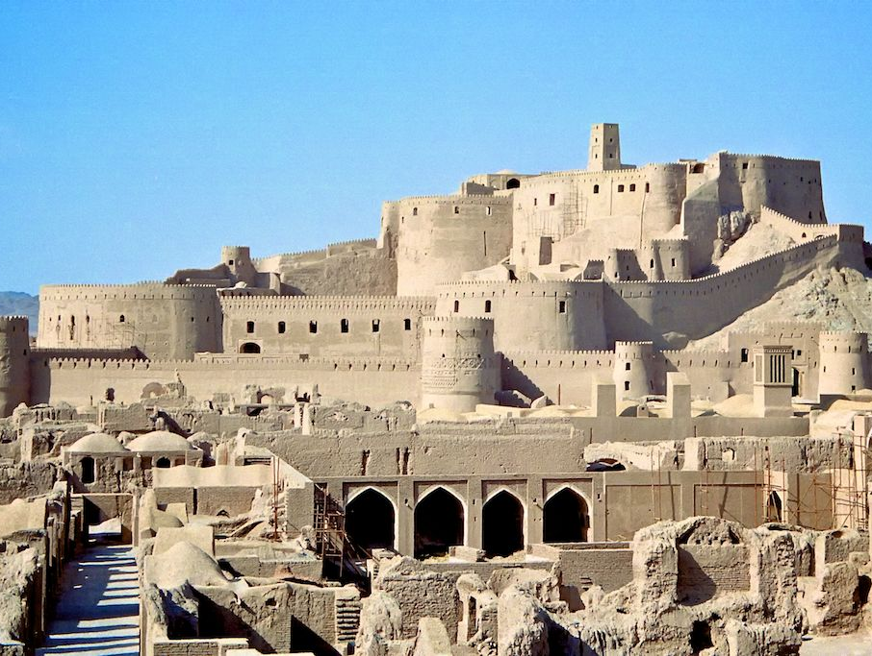
Permanent Cities and Towns
A result of surplus food supply allowing population growth
Results in the exchange of ideas
Centre of trade and production
Notes:
Tombs above ancient city of Myra, Turkey
Bam, Iran – 2000 year old city along the Silk Road – destroyed in 2003 earthquake

Slide 8
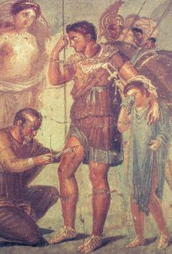
Specialized Labour
People begin to specialize in particular occupations/ professions
Doctors, government employees, builders, military specialists, teachers, merchants, artists
Notes:
The doctor Japyx heals Aeneas. Ancient Roman fresco from the Surgeon's House in Pompeii, Italy (mid 1st century)

Slide 9
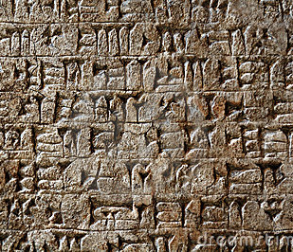
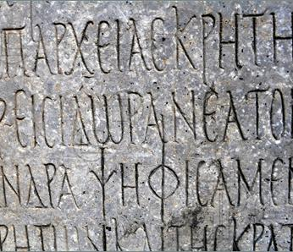
Record Keeping
Record keeping and writing marks the dawn of history. Why does this mark the beginning:?
Kings, priests, merchants and artisans needed written records to keep track of their affairs.
Earliest writing was developed in Mesopotamia, and is called cuneiform.
Taxation
Census
Religious records
Notes:
ancient-cuneiform-writing-thumb5758874
Ancient-Greek-Writing-1298872

Slide 10
Complex Institutions
Government and law
Organized religion
Banking/financial system
Social Class Structure

Slide 11
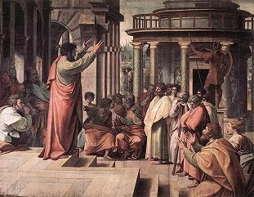
Government
Some form of government headed by a chieftain or ruling family.
Political power is mostly held in the cities.
Notes:
Raphael - Paul delivering the Areopagus sermon in Athens (1515)

Slide 12
Government
Organized bureaucracy – create the rules and laws of a society
Civil government –enforces law and order
Military – defends country against perceived threats, and obtains more territory for expansion
Notes:
Raphael - Paul delivering the Areopagus sermon in Athens (1515)

Slide 13
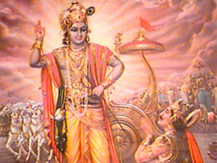
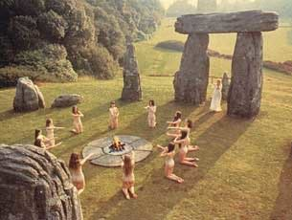
Religion
Professional priestly class served the gods who protected the community
Complex organization with a number of different levels of power and authority
Gods deemed crucial to community’s success.
The establishment of organized religion and education rather than simply the following of traditions of ancestors.
Notes:
krishna - hinduism
stonehenge-ritual

Slide 14
Merchants and Trade
Trade and the use of money.
Often regulated by government.
Access to goods not produced locally
Notes:
Raphael - Paul delivering the Areopagus sermon in Athens (1515)

Slide 15
Social Class Structure
Based on economic power
Hierarchy based on who had the most power and wealth
Why are some people seen as more important/necessary than others?
Division of labour and power
Delineation of gender roles
Notes:
krishna - hinduism
stonehenge-ritual

Slide 16
DO NOW! Grab a piece of paper
Are there characteristics of a civilization that you think should be included?
Are there characteristics that you think should be taken out?
What do you notice about what these characteristics say, and what they don’t say? Who do you think came up with these characteristics?

Slide 17
Additional Elements that are Needed for civilization
A safe and secure water supply
water is the basis for life
allows for growth of cities
creates transportation and trade routes
A secure and stable food supply that can produce surpluses
food = population growth = cultural development

Slide 18
And now for something completely different…

Slide 19
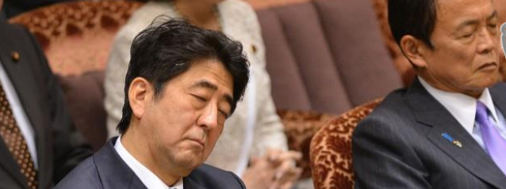
Japanese Prime Minister Shinzo Abe (L) and Finance Minister Taro Aso “listen” to a question from an opposition lawmaker during a budget session at the national Diet in Tokyo in February 2013.

Slide 20
Before approaching a foreign culture, means first and foremost understand that culture is made of many different features and nuances. Knowing this can prevent from spreading “funny” misconceptions.

Slide 21
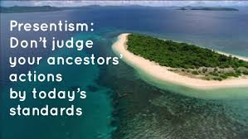
The Same can be said for the past
It is important that we understand culture, and the values, beliefs and ideas that feed it, are very different in past cultures.

Slide 22
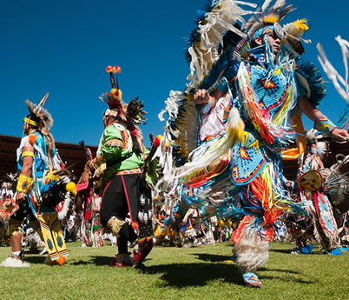
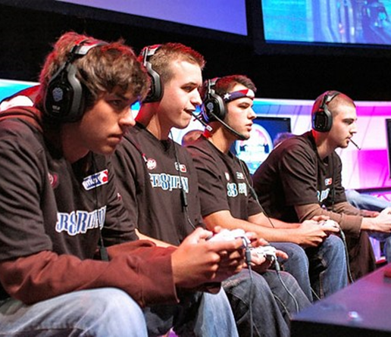
What is Culture?
“learned behavior patterns that are characteristic of the members of any given society” (Oosterwal)
…gives people “a sense of who they are, of belonging, of how they should behave, and of what they should be doing." (Moran, Harris and Moran)
Notes:
Raphael - Paul delivering the Areopagus sermon in Athens (1515)

Slide 23
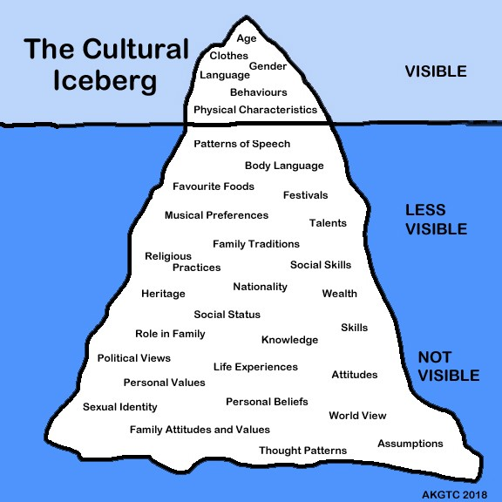

Slide 24
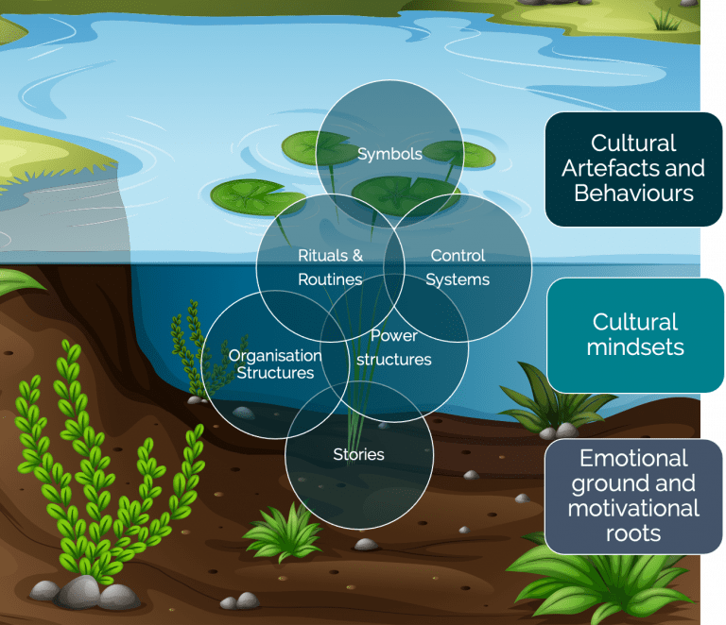
The lilypond analogy of Culture
Food, clothing, rituals, art, etc
Changes in the ecosystem influence culture – technology, exposure to new ideas, economic climate, etc.
Basic Underlying Assumptions(own personality, national culture, organizational culture,, values, experience, world view)

Slide 25
The Lilypond Analogy – Cont.
Culture is an ecosystem that is living and changing constantly
You see things above the surface that are nurtured from below
When you look in the pond, what do you see staring back at you? Culture reflects the influence of leader(s) of a community
culture is dynamic not static.

Slide 26
7 Characteristics of Culture
Culture is:
Learned
Transmitted
Based on Symbols
Changeable
Integrated
Ethnocentric
Adaptive

Slide 27
Culture is
Culture is not innate (instinctual)
Is gained through living in a specific place (where one is raised)
Learned through interaction, observation and imitating others
Provides a list of behaviours that are permissible
Ie: How to dress in general, but also in specific situations
Acquired both consciously and unconsciously (but mostly unconsciously)

Slide 28
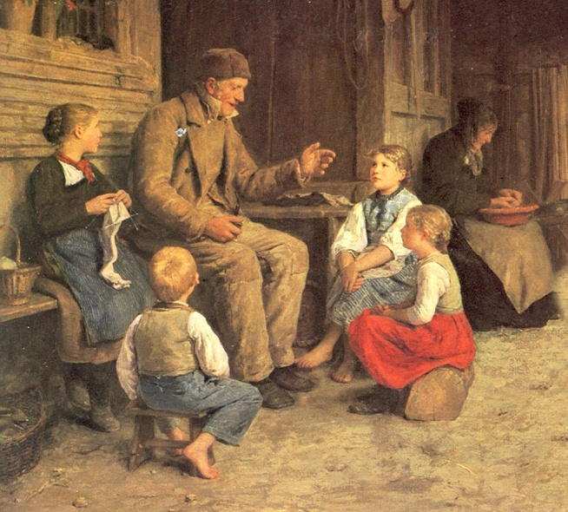
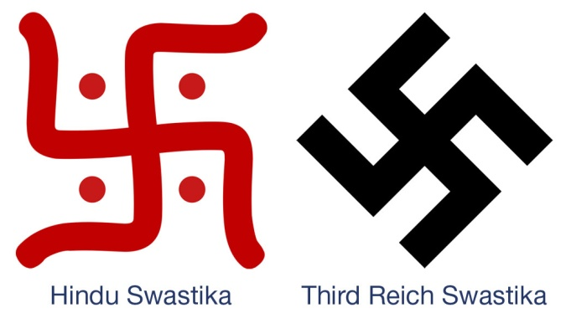
The Characteristics Explained Cont.
Language is a major component (both verbal and non-verbal)
Images and Icons - Meaning recognized by people within the culture
Symbolic meaning can change
Passed on from older generation to the younger members of community
Older generation constantly reinforces the culture in younger gen.
Culture dies when it is not transmitted
Culture is Transmitted
Culture is Based on Symbols
Notes:
*The name Swastika is derived from the Sanskrit language, from “su,” meaning “good,” and “vasti”,” meaning “being” (together; well being).. The swastika is a type of solar cross, with arms bent at right angles, suggesting a whirling or turning motion. swastika used in Buddhist art and scripture is known as a Manji, and represents Dharma, universal harmony, and the balance of opposites.
First image not in source images
Swastika types
Anker Grossvater - Storyteller [1884]

Slide 29
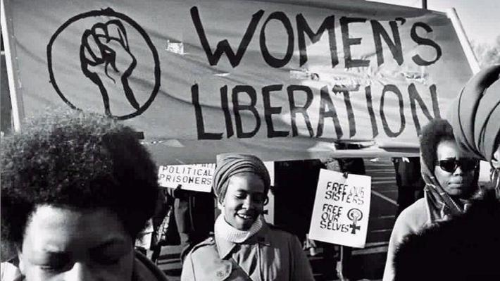
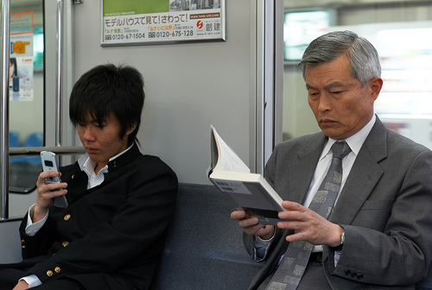
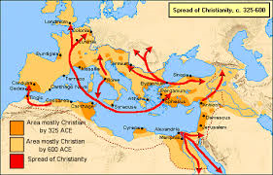
The Characteristics Explained Cont.
Culture does not exist in a vacuum, so it is not static
Change is can even be seen from generation to generation
Takes place through discovery (innovation), borrowing (diffusion), or prolonged contact with other cultures (acculturation)
All the parts of a culture are related to one another
Changes to one aspect/dimension will impact other aspects/dimensions (ie: change in religion)
Culture is Changeable
Culture is Integrated
Notes:
women's lib. Movement
generation gap
Map not in source images

Slide 30
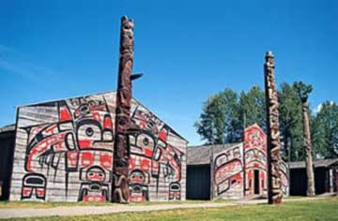
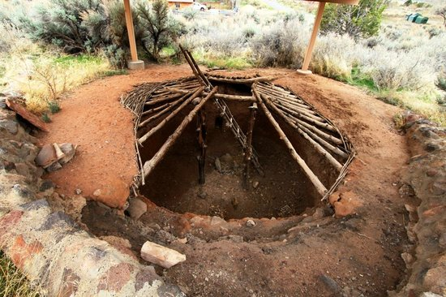
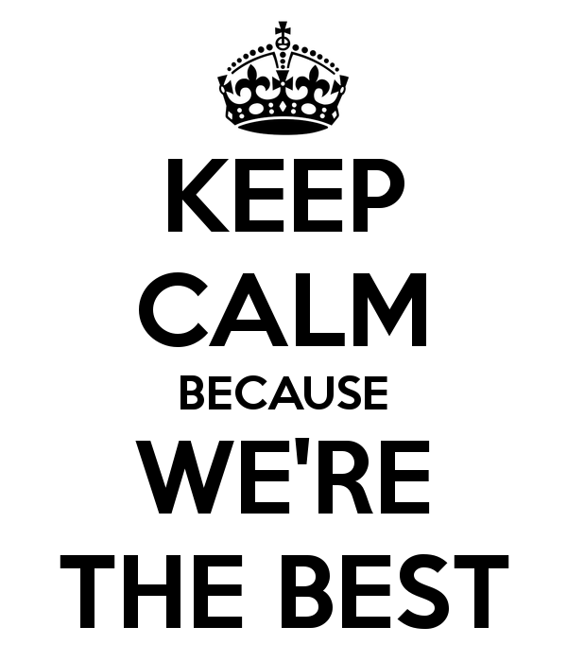
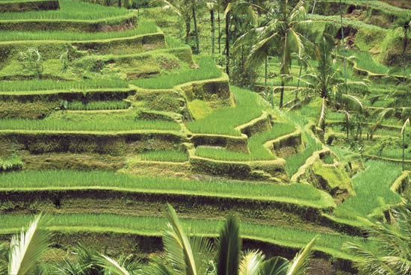
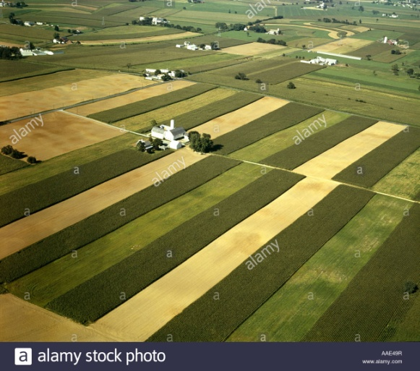
The Characteristics Explained Cont.
Belief that one’s culture is superior or more worthy than another
Common to judge other cultures
To survive, culture must adapt
For example, we adapt to our environment through culture rather than genetic aspects
Physical differences in humans are superficial, but cultural differences are more substantial
Ie: farming techniques, clothing styles, housing
Culture is Ethnocentric
Culture is Adaptive
Notes:
First image not in source images
anasazi-indian-village - pithouse at Coombs site in Utah
Longhouses at Ksan Village
Irrigated rice terraces, Bali, Indonesia.
AERIAL STRIP FARMING PENNSYLVANIA

